Slide 1
Thrills! & Chills of Online Data Collection
Brian D. Doss, Ph.D.
Associate Professor
University of Miami
bdoss@miami.edu

Slide 2
Where we’re headed:
Data Collection
Why online?
Access & Representativeness
Sampling & Costs
Recruitment: Social media & Google
Crowdsource: Mturk & Qualtrics
Logistics
Complex data collection & Security
Data Quality
Inattentive responding

Slide 3
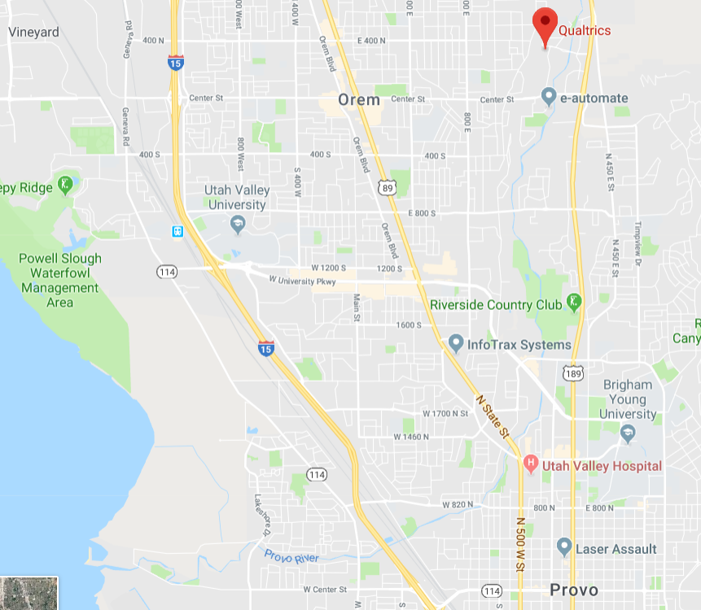
Qualtrics

Slide 4
Data Collection:
Why online?

Slide 5
Access to Populations!
Stigmatized questions
Populations
Topics
Example: Couples with severe domestic violence seeking help online
Low base rate questions
Disorders (medical or psychological)
Events
Example: Online intervention for post-partum GAD

Slide 6
Access to Populations!
Geographic restrictions
Overcome demographic characteristics in your area
Cross-cultural research
Example: Online intervention for post-partum GAD … in rural West Virginia

Slide 7
Representativeness – Thrill! & Chill
Better than undergraduate samples
A lot of what we know about relationships (especially from social psychology) is from 1st year (female) college students.
But how representative are they?
Internet users in general

Slide 8
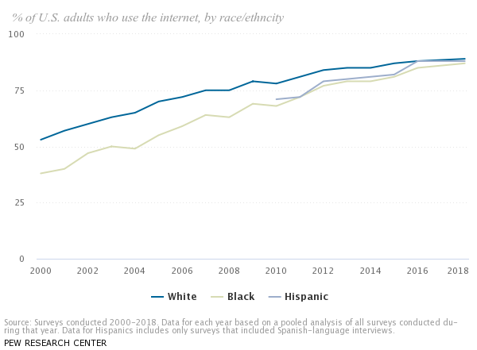
Thrill!

Slide 9
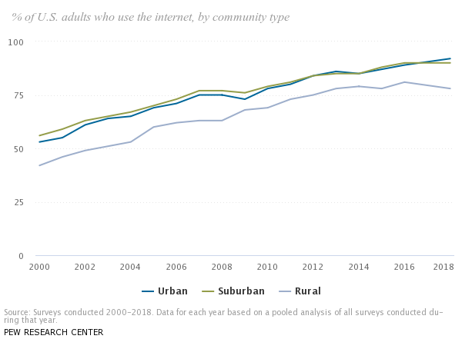
Thrill!

Slide 10
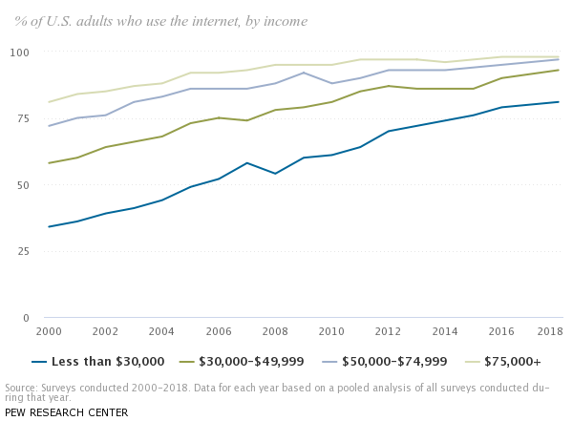
Thrill! & Chill

Slide 11
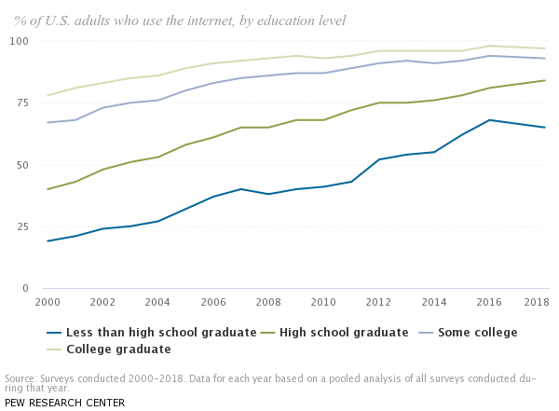
Chill

Slide 12
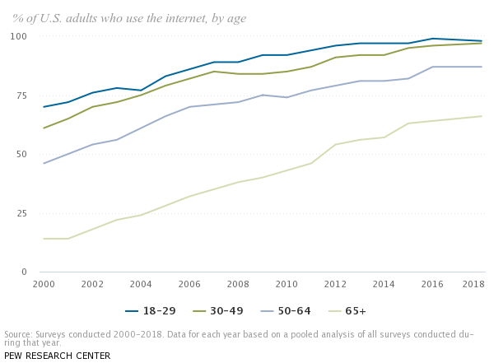
Chill

Slide 13
Representativeness – Thrill! & Chill
Better than undergraduate samples
A lot of what we know about relationships (especially from social psychology) is from 1st year (female) college students.
But how representative are they?
Internet users in general
Internet you pick to be in your study

Slide 14
Representativeness – Thrill!
You can select for samples with specific characteristics
Facebook advertising
Demographics, interests, friends, etc.
Google advertising
Searches, some demographics
Mturk
Location, demographics, pre-screener
Qualtrics Panels
They will find specific groups meeting your needs
Add questions to a nationally-representative sample

Slide 15
Data Collection:
Sampling & Costs

Slide 16
Recruitment vs. Crowdsource
Recruitment
Crowdsource
Use online methods to let people know about your study
Social Media
Facebook
Twitter
LinkedIn
Google / Bing
Organic results
Search ads
Display ads
Use online groups to pay them to do your study / fill out your survey
Mturk
Qualtrics Panels

Slide 17
Recruitment vs. Crowdsource
Recruitment
Use online methods to let people know about your study
Social Media
Facebook
Twitter
LinkedIn
Google / Bing
Organic results
Search ads
Display ads

Slide 18
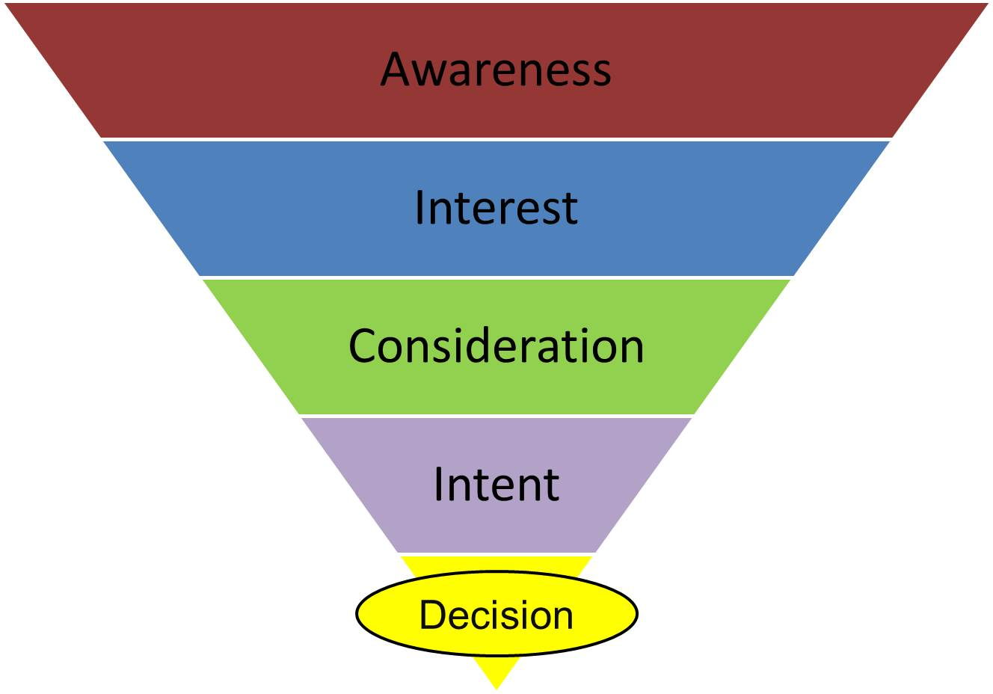
Recruitment
Facebook
Relationship websites / Google Display

Slide 19
Recruitment - Facebook
Notes:
If we weren’t asking so much of people (e.g., quick survey), this would have likely been more successful.

Slide 20
Recruitment
Facebook
Relationship websites / Google Display
Google / Bing / Yahoo Search

Slide 21
Recruitment vs. Crowdsource
Recruitment
Crowdsource
Use online methods to let people know about your study
Social Media
Facebook
Twitter
LinkedIn
Google / Bing
Organic results
Search ads
Display ads
Use online groups to pay them to do your study / fill out your survey
Mturk
Qualtrics Panels

Slide 22
Craigslist etc – the ultimate Chill
I don’t recommend it!
Prince et al., 2012 (Behavior Therapist)
94% of responses to online diary study were done by computer “bots”
And that was in 2012! Think about how much havoc they can create now!
Very important you make sure that your participants are actual people and that they’re not paid until you check the quality of the work.

Slide 23
Crowdsource: Mturk
Crowdsourcing your research
People who will answer your surveys as a “job”
Good for you (bad for them) – they don’t get paid much!
Advantages over Craigslist
They are anonymous to you, but not to Mturk. If they don’t do the tasks well, the system punishes them.
You have the (default) ability to review their work before you pay them.
Can “handoff” between Mturk, Qualtrics, and back
Mturk workers can be linked to your Qualtrics survey
At the end of the Qualtrics survey, you can provide them with a one-time use code
User enters that code into Mturk to get paid (pending your approval)

Slide 24
Crowdsource: Mturk Thrill! & Chill
Mturk samples:
Pretty darn representative of the general US population!
Some evidence that they may have more psychological difficulties
Some evidence they are slightly older and more racially / ethnically diverse than internet users in general

Slide 25
Crowdsource: Mturk – Costs
Costs are low, but increase as you narrow your sample:
Base rate: ~10¢ for 10-item survey + 20% mTurk fee
Age: 50¢ per assignment
Gender: 50¢ per assignment
Income bracket: 50¢ per assignment
Language fluency: $1 per assignment
If you need a very specific sample (or things they don’t let you limit on), consider a pre-test.

Slide 26


Crowdsource: Qualtrics Panels
Mturk:
Qualtrics Panels:

Slide 27
Crowdsource: Qualtrics Panels
Nationally-representative data (or subset thereof)
Option #1 – Your own survey
$5 for each 15 minute survey
Option #2 – Sample of 1,000 people
$200 per question you add
(Sample demographics are included)

Slide 28
Crowdsource: Qualtrics Panels
Qualitative Interviews
Recruit 15 participants for a 30min interview
Screened for questions not in their database (relationship distress, help-seeking)
$7,500

Slide 29
Data Collection:
Logistics

Slide 30
Logistics – Thrill!
Easier & faster – participants enter their own data!
Flexible
Same survey administered:
Across smartphones and computers
Across languages
Surveys can be:
Standalone
Embedded in your webpage
Embedded in social media
Delivered via text:
Link to survey (opens in browser)
One question at a time via 2-way text

Slide 31
Logistics – Thrill!
Using Qualtrics “Logic”
Branch / Display – Showing questions conditionally (including random)
Landing – What text user sees / where they go when done
Email – Send a conditional email upon survey completion
Contact List – Conditionally add a respondent to a contact list
Custom validation – Conditionally restrict access to survey / part of survey

Slide 32
Logistics – Thrill!
More advanced Qualtrics logic features:
Send a tailored email to participant or to someone else (e.g., suicidality)
Immediately
On a delay
Add a participant to a contact list (no double-entry needed)
Eligible participants following a screening survey
Can then send subsequent surveys to these people.
Separate contact lists according to certain criteria

Slide 33

Logistics – Chills

Slide 34

Logistics – Chills

Slide 35
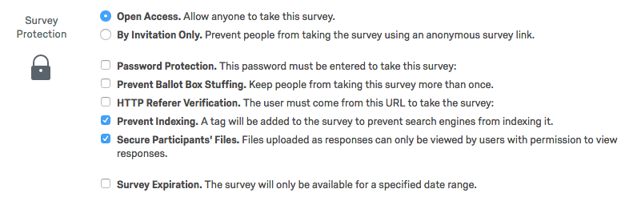
Qualtrics survey protections

Slide 36
Qualtrics survey protections
Two ways to enter survey
Anonymous link – anyone can click on it
Individual link – specific to a person

Slide 37
Qualtrics survey protections (in order of security):
Password Protection
Any general password you want to set up
Pro: Easy to distribute to anyone in your study
Con: That password could be posted publically (e.g.,. if offering payment for completion)
Prevent Ballot Box Stuffing
Someone can take the survey only once by placing a cookie in the browser
Pro: Easy solution to prevent accidental repeat submissions
Con: Switching browsers or clearing cookies gets around this.

Slide 38
Qualtrics survey protections (in order of security):
HTTP Referrer Verification
Must click the link on a certain webpage
Pro: Useful if access to the referrer webpage is restricted
Internal university page
Participants in an online program
Con: Makes completing the survey more tedious (have to log into webpage first)

Slide 39
Qualtrics survey protections (in order of security):
Authenticators
Only people who are listed in your separate contact list can take the survey via the Anonymous Link.
To make this work:
Added into Survey Flow (just like branch logic or randomizers) – so can be used at any point (e.g., just before payment).
Create a contacts list within Qualtrics (more on this later)
Authenticates against emails and/or “ExternalDataReferences” – most things are possibilities.
If no match after several attempts, they are skipped past that section
E.g., could be told to contact project staff directly for payment

Slide 40
Qualtrics survey protections
Two ways to enter survey
Anonymous link – anyone can click on it
Individual link – specific to a person
Easiest if you have people in a contact list

Slide 41
Data Collection:
Quality of the Data

Slide 42
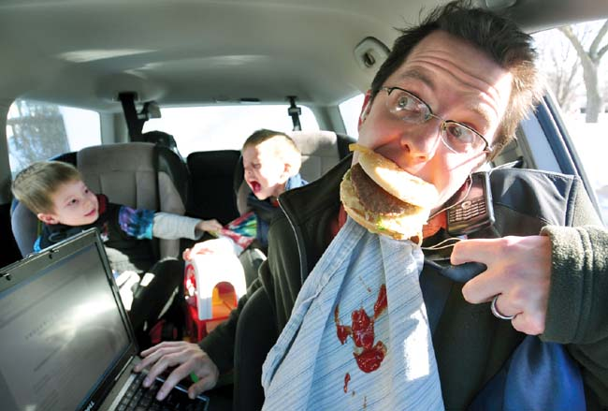

Slide 43
Data Quality
Chills: Careless and/or insufficient responding is an issue!
Across a number of studies, about 10% of responses can be classified as such (Curran, 2016), with reasonably large variability between studies.
May be a big issue or a little issue for your study, but it will probably be an issue ….
Thrills: However, similar to in-person assessment (Oppenheimer et al., 2009)
Caveat – Research not sufficient on smartphone & text responses.

Slide 44
Data Quality – Thrills!
You can do something about this!
Use as a rule-out / eligibility factor
During data cleaning after the fact
Common ways to detect problems
Response times
Long strings of same answers (B-B-B-B-B)
Inconsistency across very similar items asked twice (on MMPI and PAI)
Instructional manipulation check (at the end of a long paragraph of instructions)

Slide 45
Data Quality – Thrills!
Attentive Responding Scale (ARS-18; Maniaci & Rogge, 2014)
6 infrequency items
6 pairs assessing consistency (12 items)
Directed Questions Scale (7 questions; Maniaci & Rogge, 2014)
“To show that you are reading these instructions, please leave this question blank”

Slide 46
Data Quality – Thrills!
Inattentive responses affect your results
These participants were:
Less likely to finish watching a short video
Had scales with lower internal consistency
Eliminating responses using just a single “directed question” increased power by 2-3%

Slide 47
Data Quality – Thrills!
Important across sample sizes
(Maniaci & Rogge, 2014)

Slide 48
Data Quality – Thrills!
The more careless responding, the more important it is to screen for it!
(Maniaci & Rogge, 2014)

Slide 49
What we’ve covered:
Data Collection
Why online?
Access & Representativeness
Sampling & Costs
Mturk & Qualtrics
Logistics
Complex data collection & Security
Data Quality
Inattentive responding

Slide 50
Thrills! & Chills of Online Data Collection
Brian D. Doss, Ph.D.
Associate Professor
University of Miami
bdoss@miami.edu

